Slide 1
Data Ethics and Governance: Ethical Principles and Moral Character
SOCM033
Week 11, T1 (2022/23)
Dr. Silvia Milano – University of Exeter

Slide 2
Reminder!
Summative assignment (essay) due 9 January.
100% of the final mark!
Try to get feedback on essay outline from your tutors and peers.
Essay examples on ELE
Assessment criteria: https://vle.exeter.ac.uk/course/view.php?id=9850

Slide 3
Reminder!
Essay topic: consider one or more institutional, ethical and/or social concern involved in using data within a specific project or case study.
This can be a case that you are familiar with from your own experience; or it can be a case you have read about (e.g. in the news or in scholarly work) and whose details you are interested in exploring in more detail. The essay needs to explore the implications of the issue(s) at hand, the challenges they pose and the way to overcome those challenges. You need to be as specific as possible about the details of the case you chose: vague discussions of data ethics “in general” won’t be acceptable. You are welcome to write your essay on the same topic on which you did a presentation, but this is not compulsory.
Sources and references: you are asked to reference at least 3 of the readings listed in this syllabus and complement those sources with additional ones of specific relevance to your chosen topic.
Length:
3000 words (excluding bibliography) for students taking the 15 credits version of the module [SOCM033/PHLM011]

Slide 4
Reminder: Marking criteria
Focus: How well-formulated is your main claim/question?
Argument: How clear and convincing are the arguments you offer? Is there evidence of original research, independent thinking?
Background: How well did you prepare (is there evidence of relevant background reading, including both scholarship on data ethics ad governance from the syllabus and sources documenting your specific topic)? How well do you understand the issues?
Structure and Style: Is your essay structured in a logical, efficient manner? Is your writing clear and well-structured?
Full description on ELE page Microsoft Word - CriteriaEssayMarking.docx (exeter.ac.uk) and the video.

Slide 5
This week
AI Ethics principles vs practice
Hippocratic oath
Principlism
What next? AI ethics as practice
Technology and the examined life
Transparency
The examined self
Moral nudges

Slide 6
This week
AI Ethics principles vs practice
Hippocratic oath
Principlism
What next? AI ethics as practice
Technology and the examined life
Transparency
The examined self
Moral nudges

Slide 7
Principlism in AI ethics
AI ethics frameworks are many and varied
They seem to converge on a restricted set of high-level principles.
Key ethical principles according to Floridi and Cowls (2019):
Beneficence
Nonmaleficence
Autonomy
Justice
Explicability (which includes intelligibility and accountability)

Slide 8
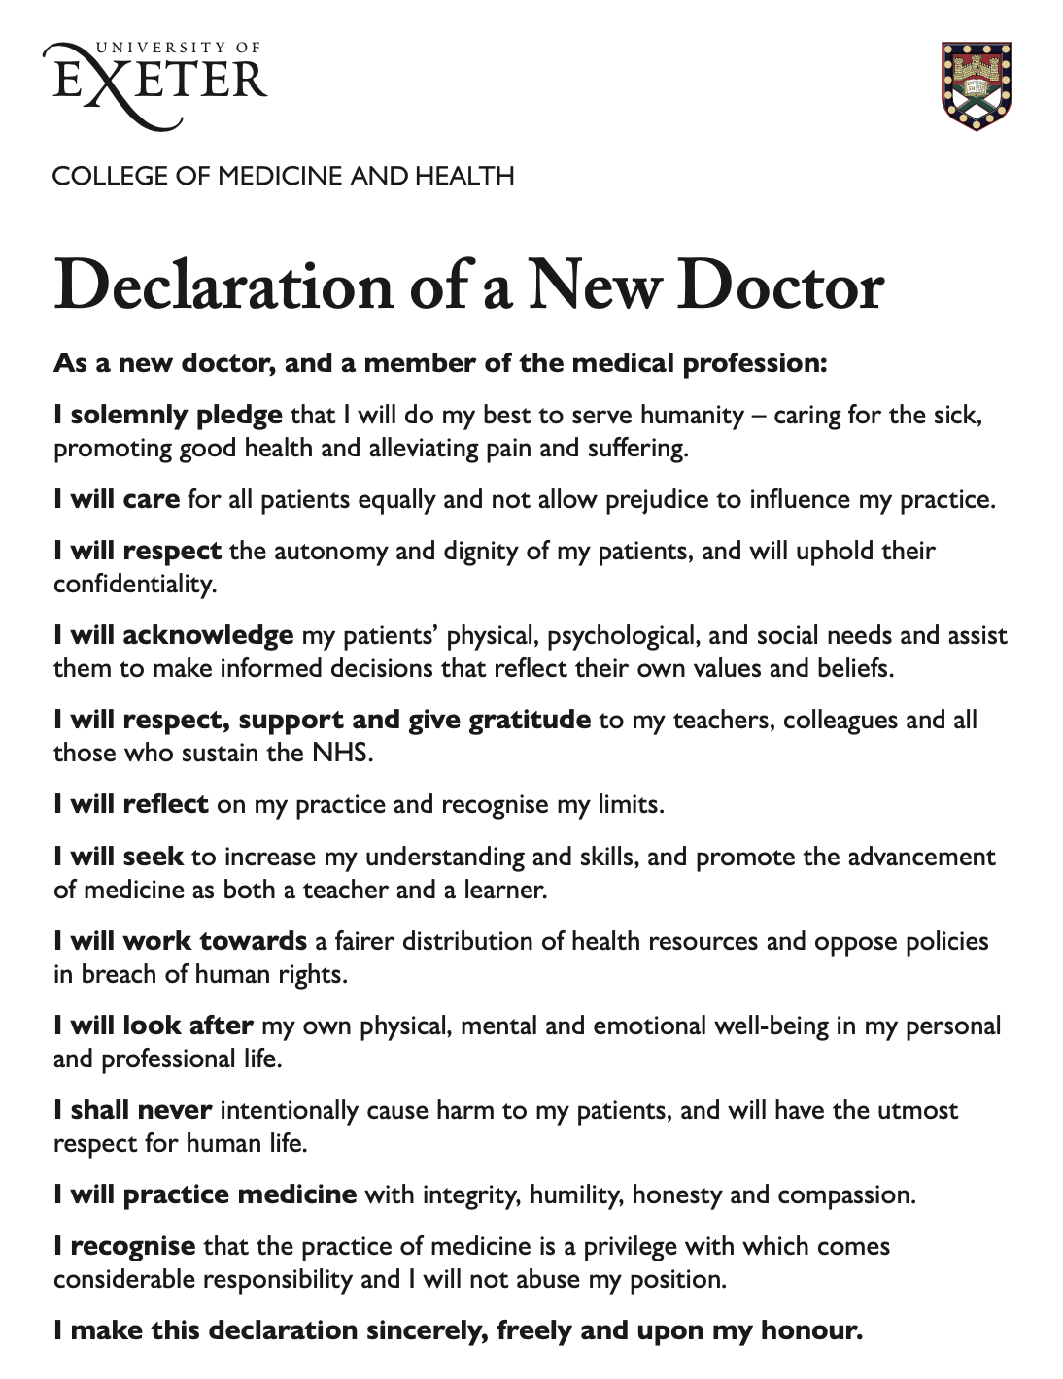
An Oath for Data Scientists?
I solemnly pledge that I will do my best to serve humanity
I will […] not allow prejudice to influence my practice
I will uphold [my patients’] confidentiality
I shall never intentionally cause harm
→ Hippocratic Oath for Data Scientists?

Slide 9
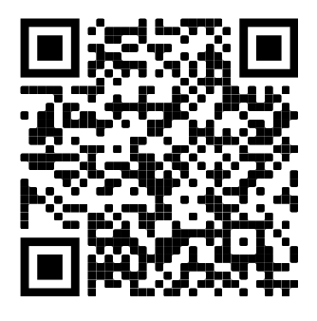
An Oath for Data Scientists?
O’Neill (2016): Yes! (one of many measures)
National Academies of Sciences, Engineering, and Medicine (2018):
I will apply, for the benefit of society, all measures which are required, avoiding misrepresentations of data and analysis results.
I will respect the privacy of my data subjects, for their data are not disclosed to me that the world may know […]
Notes:
We see that this touches on really complex topics. What counts as benefit? Can there be trade-offs between broader benefit for society and individual privacy? At what point does data manipulation turn into misrepresentation?

Slide 10
Principlism
Mittelstadt: there are barriers to the principled approach to AI ethics.
Compared to medicine, AI development lacks
(1) common aims and fiduciary duties,
(2) professional history and norms,
(3) proven methods to translate principles into practice, and
(4) robust legal and professional accountability mechanisms.

Slide 11
Principlism
(1) common aims and fiduciary duties
Medicine is guided by the aim to promote the patient’s health
What is the aim of data science?

Slide 12
Principlism
(2) professional history and norms
Reducing the field to a single vocation or type of expertise would be an oversimplification.
Systems are opaque, and no single person has a clear understanding and responsibility
Presence of conflicting stakeholder interests
Vague statements of principles hide political and ethical conflict

Slide 13
Principlism
(3) proven methods to translate principles into practice
High-level principles do not feature explicitly in clinical decision-making
This is bound by institutional policies
Examples: checklists, local guidelines…
Translation from high-level principles to practical norms is highly contextual, must be justified at every step.
In data work, there is no comparable empirically-proven methods to translate principles into practice.

Slide 14
Principlism
(4) robust legal and professional accountability mechanisms.
Doctors are bound by legal standards and codes of conduct upheld by professional organisations.
There is no equivalent professional body for data scientists.

Slide 15
Principlism
If principlism is not a satisfactory approach to data ethics, what then?
Clearly define sustainable pathways to impact
Support bottom-up AI ethics in the private sector
License developers of high-risk AI
Shift from professional ethics to organizational ethics.
Pursue ethics as a process, not technological solutionism

Slide 16
AI Ethics as a process
Ethics is not meant to be easy or formulaic. Intractable principled disagreements should be expected and welcomed, as they reflect both serious ethical consideration and diversity of thought. They do not represent failure, and do not need to be ‘solved’. Ethics is a process, not a destination. The real work of AI ethics begins now: to translate and implement our lofty principles, and in doing so to begin to understand the real ethical challenges of AI.
(Mittelstadt 2019, p. 5)

Slide 17
This week
AI Ethics principles vs practice
Hippocratic oath
Principlism
What next? AI ethics as practice
Technology and the examined life
Transparency
The examined self
Moral nudges

Slide 18
Virtue and flourishing
Virtue ethics: what constitutes the good life?
Human flourishing requires exercising virtue.
This is only possible through self-examination.
Ideal of the cultivated self: an examined life is a good life.

Slide 19
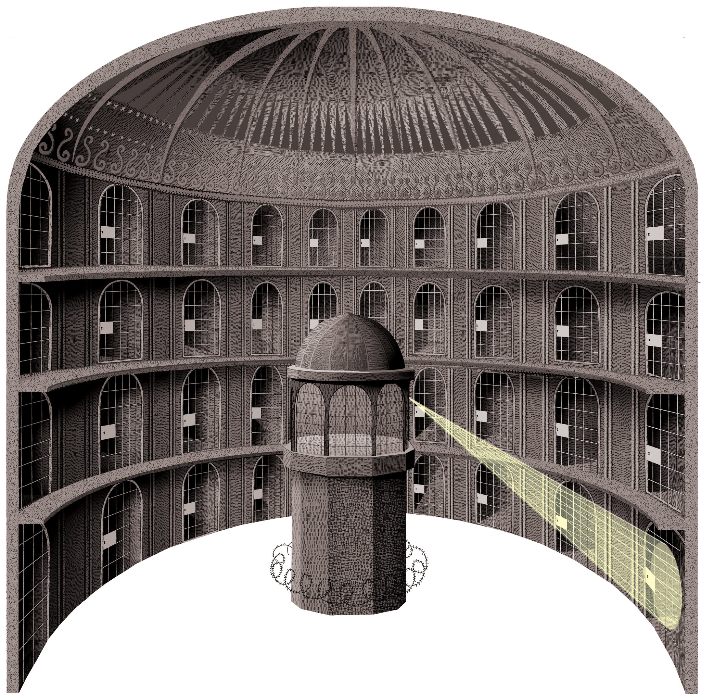
Virtue in the Panopticon
Dataveillance:
all aspects of our lives are increasingly quantified
Everything is stored somewhere and linkable to other data
Increasing process of datafication means increasing transparency
Vallor (in the reading today): how does this influence our capacity for virtue?

Slide 20
Transparency
Individuals often give up their data freely in exchange for services
Practices of self-surveillance (eg. Fitness trackers)
Not only individuals are watched, but also institutions
Whistleblowing and data leaks
Increasing push for transparency
Radical transparency: everything is measured and public

Slide 21
Transparency
Radical transparency: everything is measured and public
“What happens when every secret [is exposed], from who really did the work in the oce, to sex, to who said what, is that we get a more truthful society. … Technology is the empowerment of more truth, and fewer things taken on faith.”
(David Friedberg, CEO of a big data analytics firm owned by Monsanto, as quoted by Vallor, emphasis added)
But is this conducive to virtue?

Slide 22
Transparency
Radical transparency: everything is measured and public
What about trust, respect, compassion, humility, and flexibility?
Radical transparency encourages rigid conformism
May entrench polarisation of beliefs

Slide 23
The quantified self
the habit of self-examination is central to leading a good life
The quantified self movement:
Using technology to track every aspect of one’s life
https://www.measuredme.com/
Is this conducive to self-cultivation?

Slide 24
The quantified self
Access to datafied aspects of one’s life risks fostering obsessive attention to details
Following the philosopher Mengzi, we can see this as a self-defeating habit.
Absence of a clear vision of a normative ideal. What is the model we are trying to attain?
“Self-knowledge through numbers” evokes a merely epistemic concern
Notes:
A dataset is not a life!

Slide 25
Surveillance and moral nudges
Nudges: framing choices in a way that incentivises a certain behaviour
Moral nudges could promote good, pro-social behaviour
But this risks degrading our moral competence, and entrenching past norms
Example: using nudges for writing polite emails
Notes:
A dataset is not a life!

Slide 26
Technomoral virtues
What then?
Surveillance technologies give us new tools
But we need to use them virtuously: new technomoral virtues are needed
The ideals of radical transparency, the quantified self, and moral nudges fall short of enabling flourishing, if they are not tempered by wisdom.
Again, see AI ethics as a constant practice
Notes:
A dataset is not a life!

Slide 27
Summary
AI Ethics principles vs practice
Hippocratic oath
Principlism
What next? AI ethics as practice
Technology and the examined life
Transparency
The examined self
Moral nudges

